Slide 1
CYPRUS AIR MAIL 1920’s to 1950’s
The story is unique as Direct Air Mail Services apart from a short period in 1932 did not serve Cyprus until after WW2
Reference for this display is Cyprus Study Circle Study Paper No.3
Early Airmail prior to 1932
1932 the only period of direct international airmail services.
The Summer Only local services
WW2 period
Post WW2

Slide 2
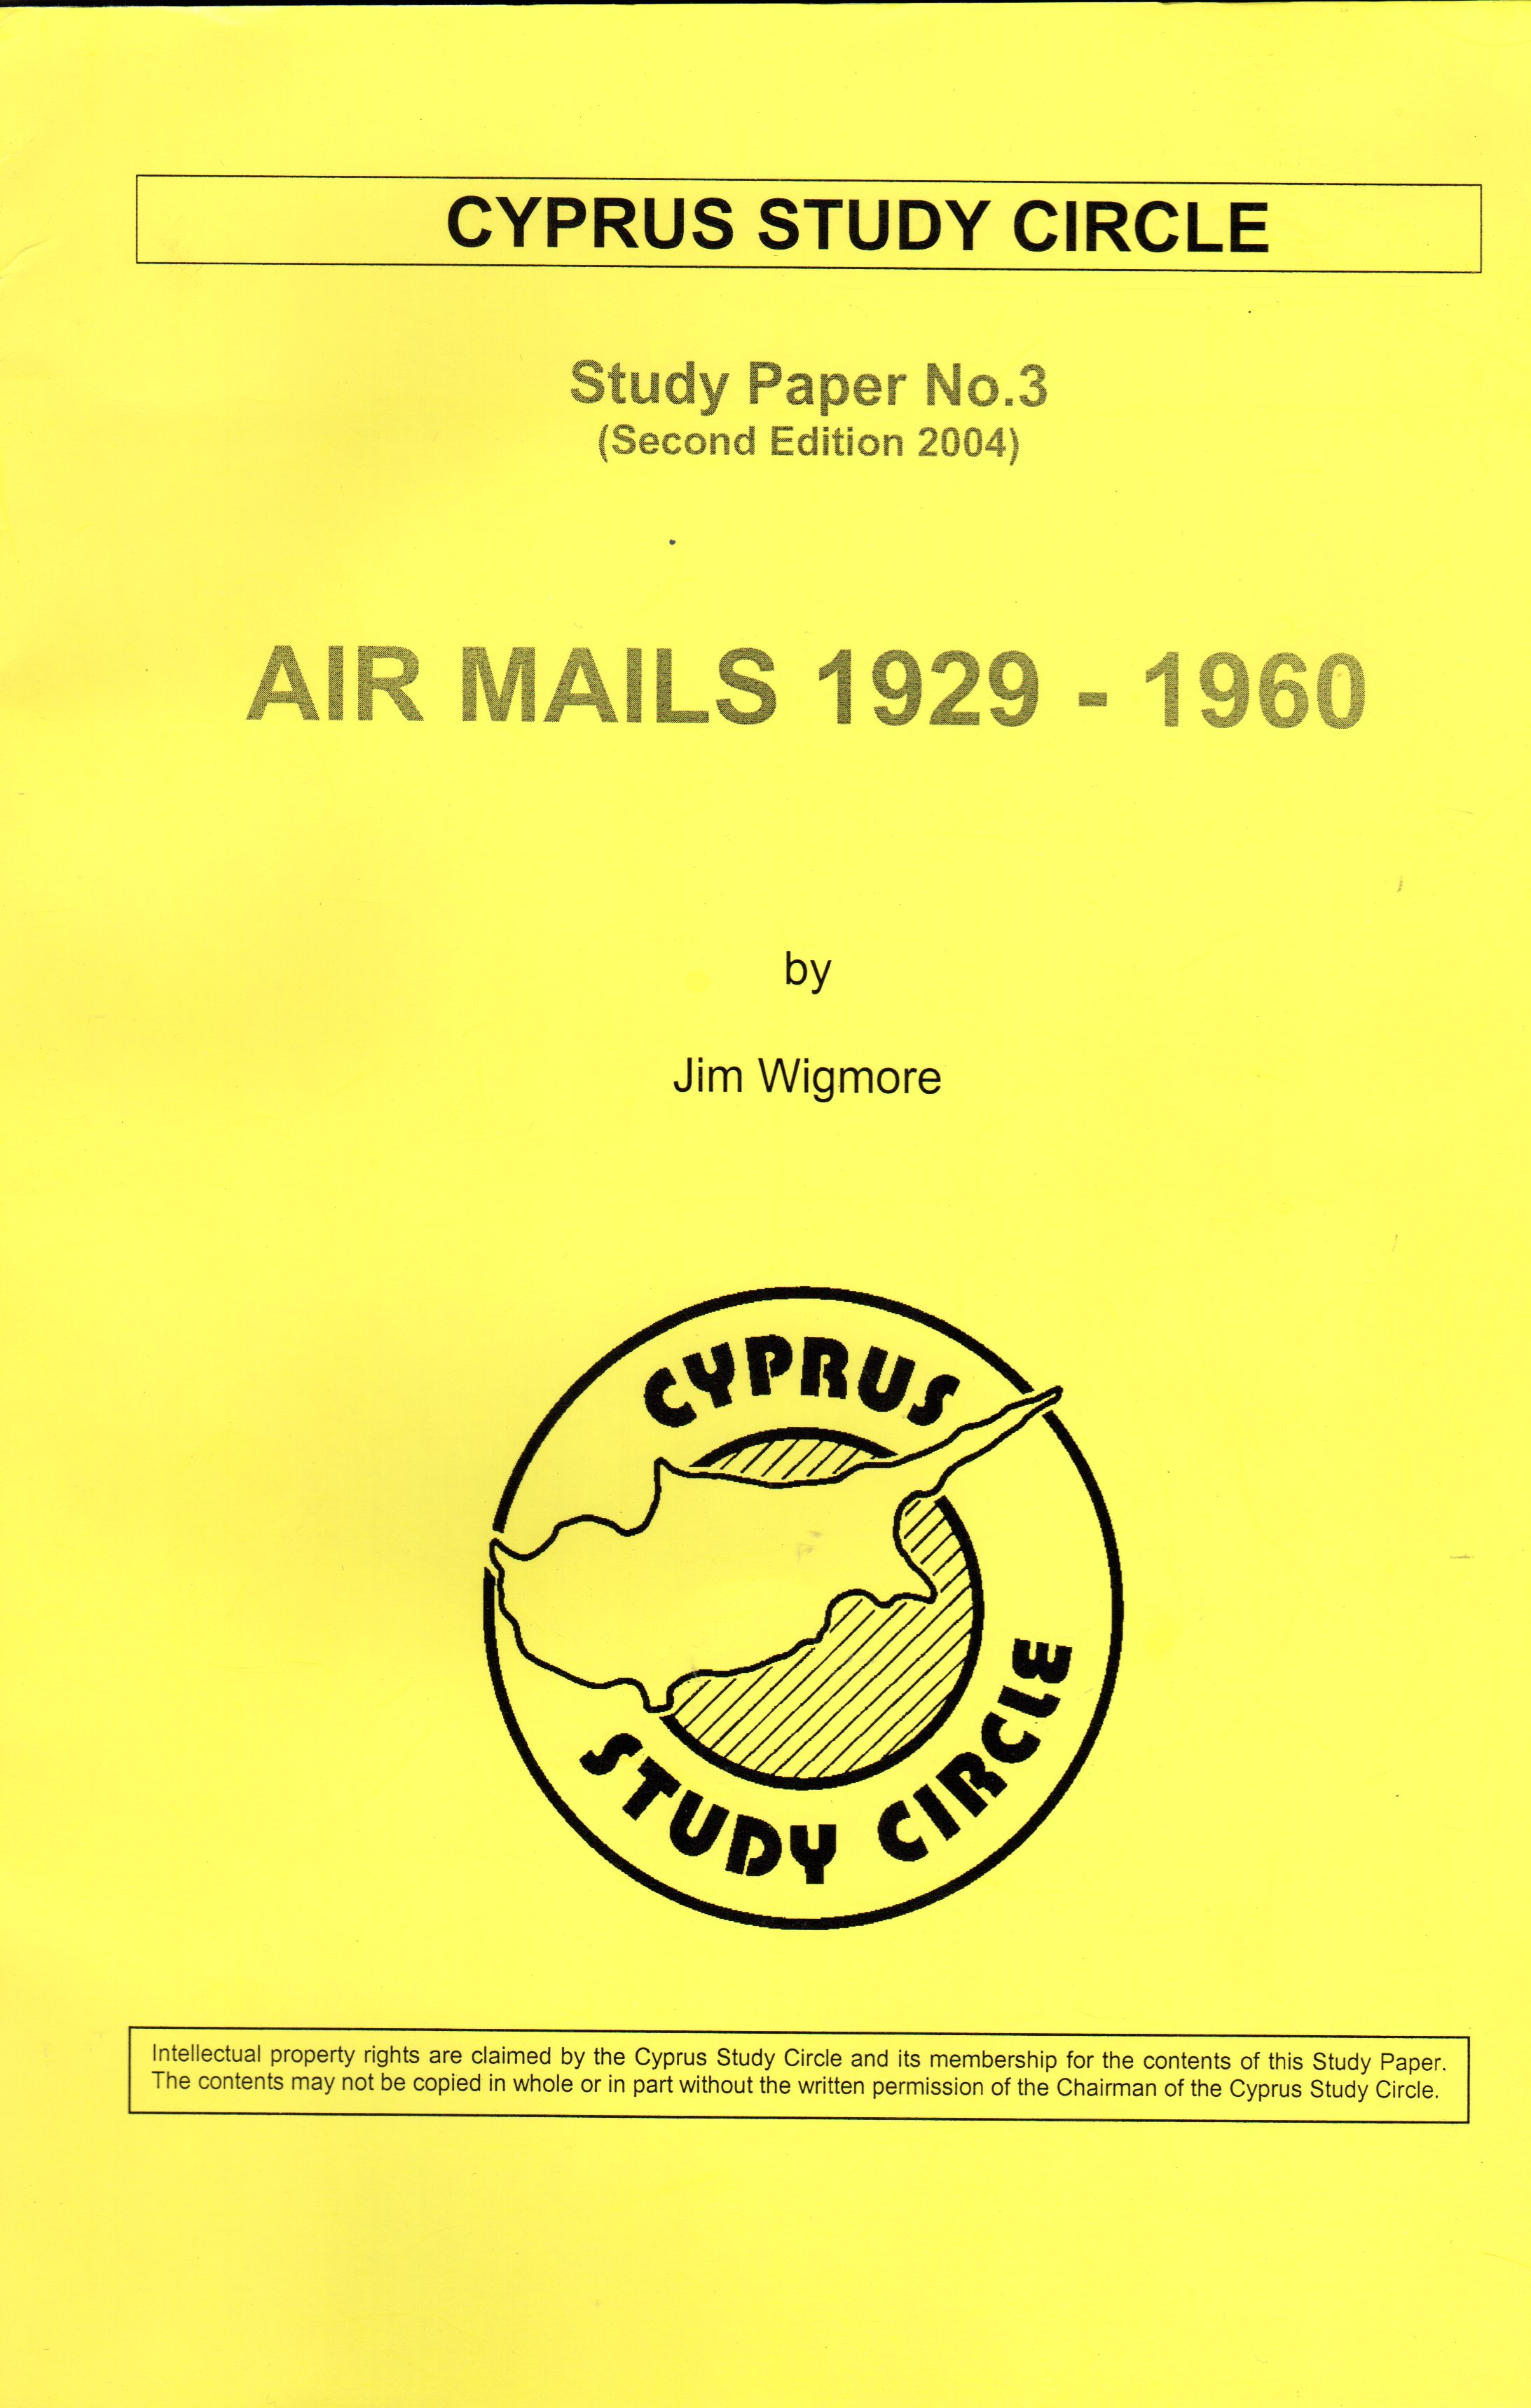
Cyprus Study Circle – SP03
Most of the following illustrations of covers have been displayed in the Cyprus Study Circle – Study Paper No3
The illustration right shows my update and vast expansion of the original study on this subject.
This study has more recently been updated once again by me to incorporate new information and expand the early flights that carried mail destined for Cyprus.

Slide 3
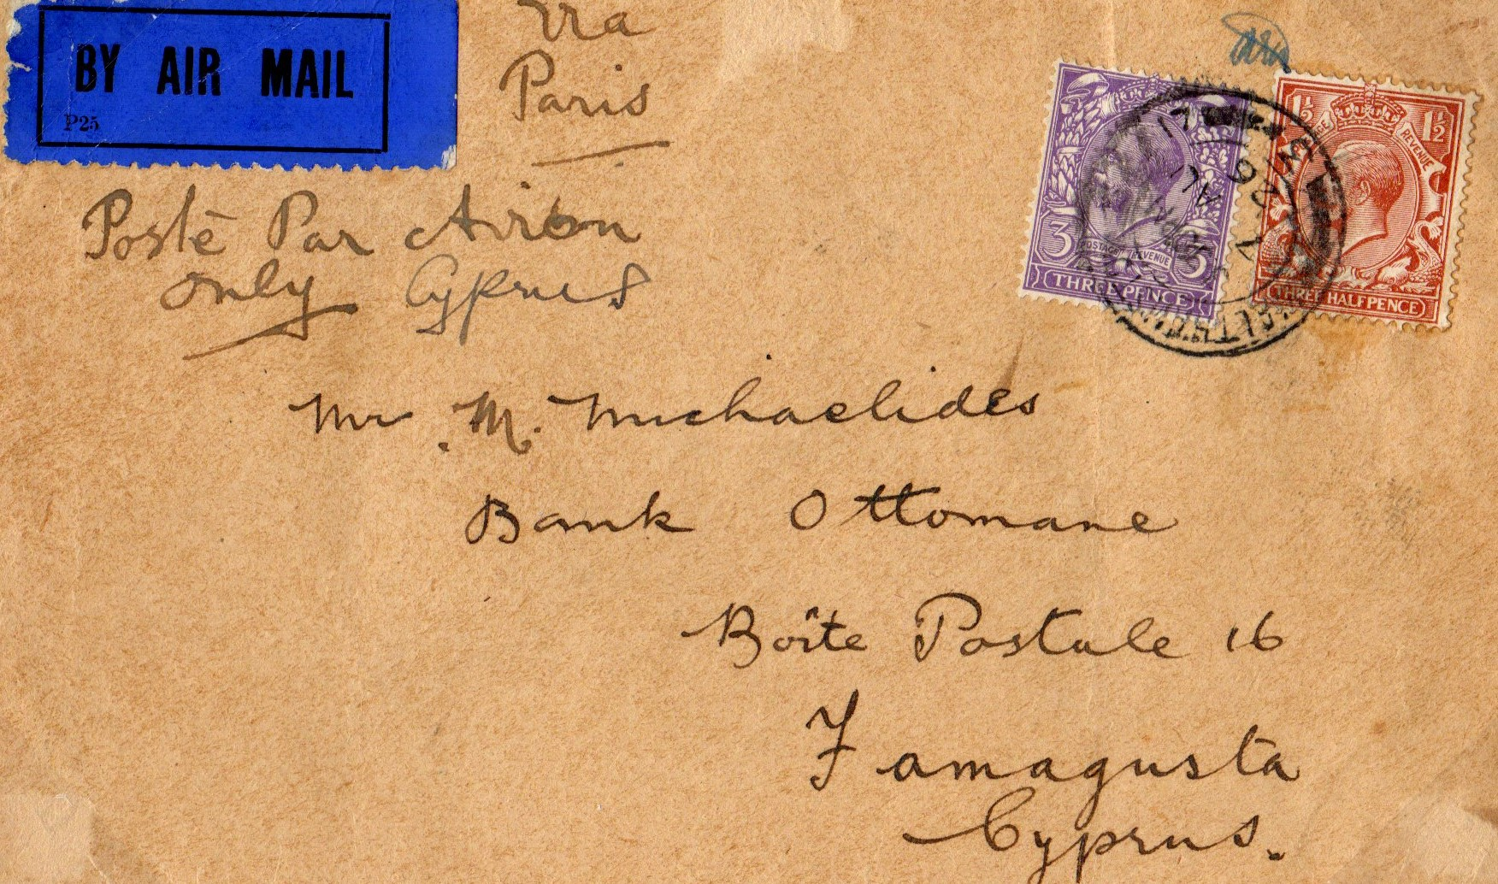
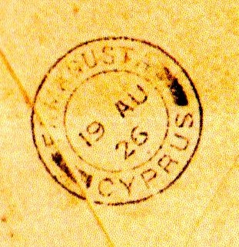
Early Airmail prior to 1932
12th August 1926
Imperial Airways London – Marseilles (ref PO Notice P635 of July 1926)
The cover is inscribed via Paris Poste Par Avion only Cyprus this was the 1st flight where the aircraft continued to Marseilles.
It is one of only two known covers to Cyprus carried on this flight arriving in Famagusta on 19th August 1926. (see backstamp shown).
It is thought the cover travelled from Marseilles by P & O Ship “Maloja”.
Postage rate was Empire mail rate of 1½ d plus 3d Airmail fee

Slide 4
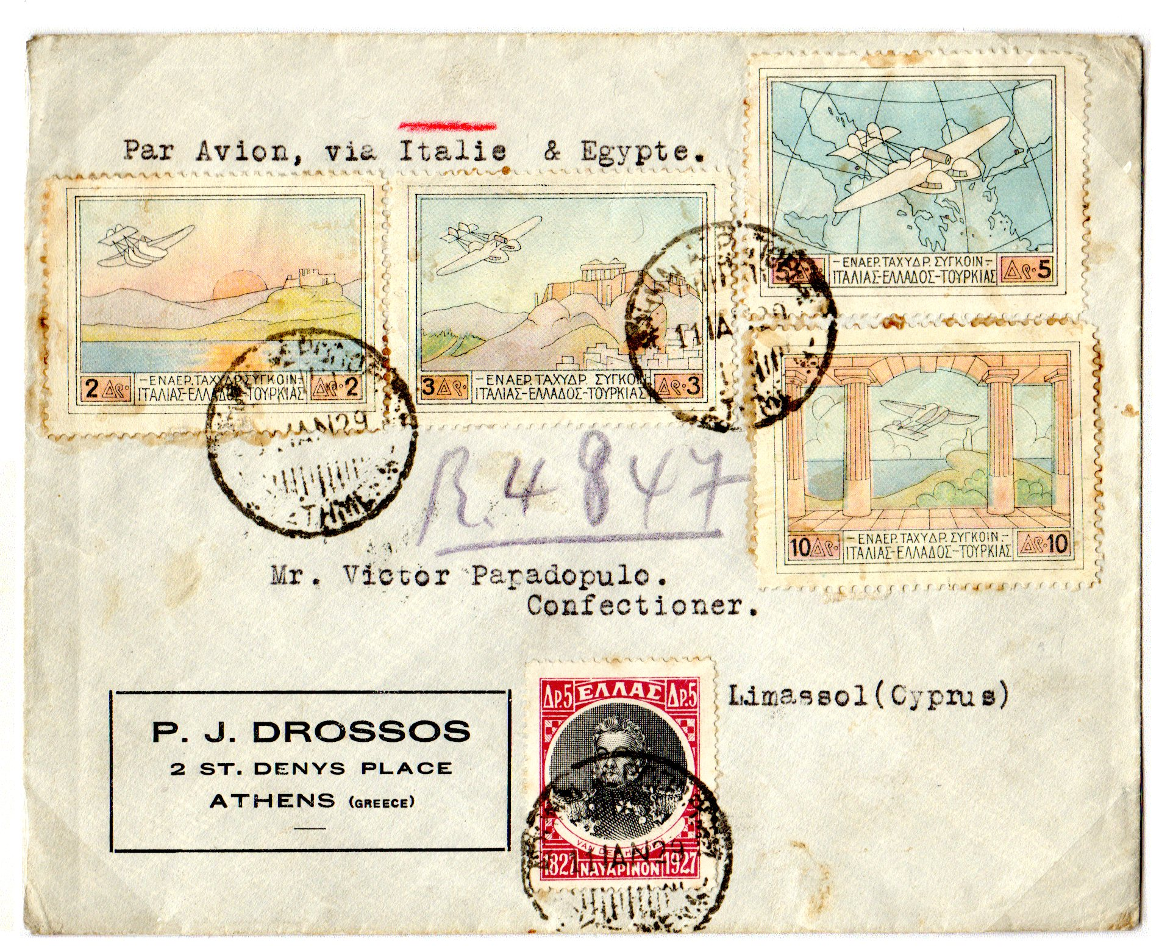
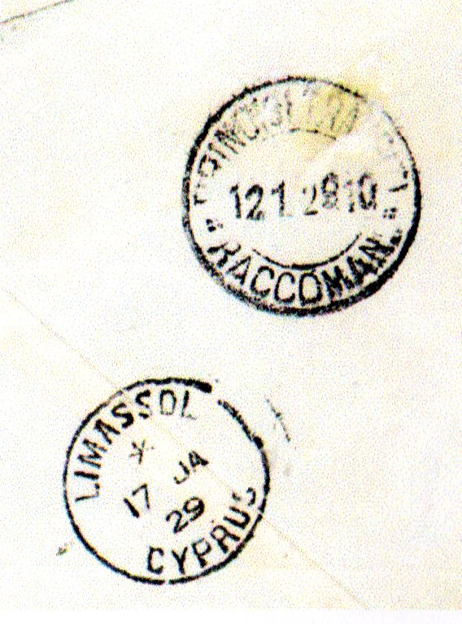
Early Airmail prior to 1932 - Cont.
ATHENS – ITALY – EGYPT – CYPRUS
Seems to be an unusual route for this cover, backstamped at Brindisi on 12 JAN 29 and has an arrival mark at Limassol on 17 JA 29 (see markings shown below).
It appears to have been registered without a label just a pencil marked Ref No.
The rather odd looking washed out Airmail Stamps are exactly as printed and the rate appears to be correct for Postage, Registration and Airmail

Slide 5
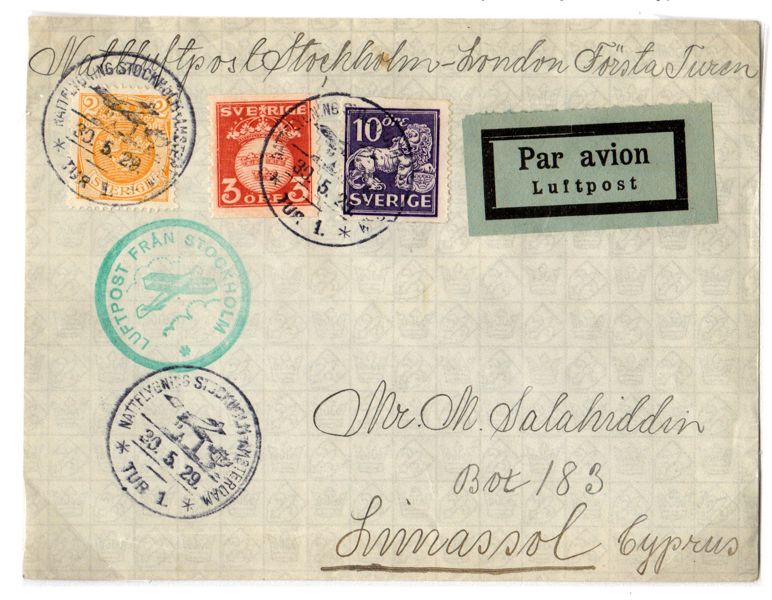
Early Airmail prior to 1932 - Cont
30th March 1929
1st Night Flight from Stockholm to Malmo then to Croydon London to be carried on the weekly Eastern Route of Imperial Airways leaving on 1st June 1929.
There are no transit marks and it is assumed it was transported by sea from Cairo to Cyprus.
No other covers are known to Cyprus from this flight.

Slide 6
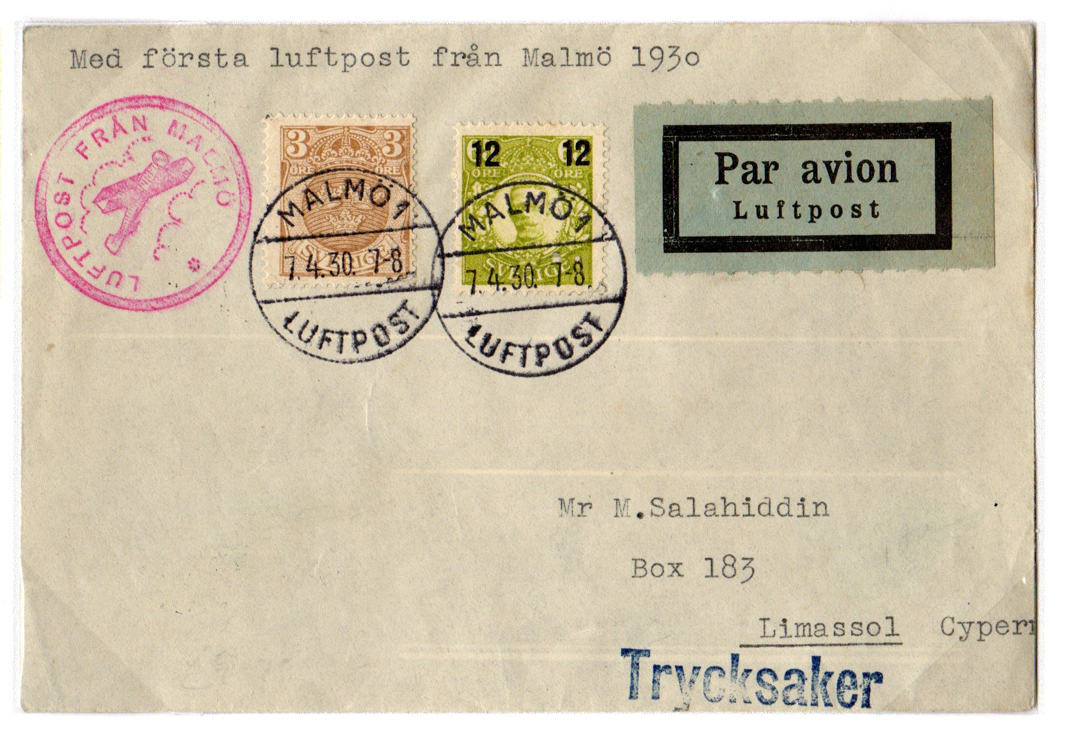
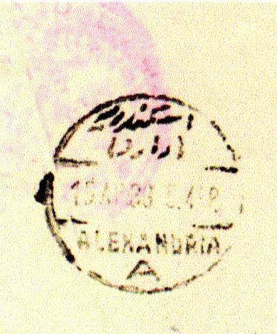
Early Airmail prior to 1932 - Cont.
12th April 1930 – 1st Flight London to Karachi
(ref PO Notice P635G Spring 1930)
This was an accelerated service from 6-8 days to 2 ½ days. Mail went by air from London-Cologne-Nurnburg-Vienna-Budapest-Athens-Crete and Alexandria to Karachi.
7th April 1930 – This cover from Malmo Sweden to Limassol Cyprus was routed to meet the above flight. It was backstamped 15th April 1930 on arrival at Alexandria (shown right). It would then have travelled by Khedival Mail Line to Cyprus.
The cover is stated to be RARE

Slide 7
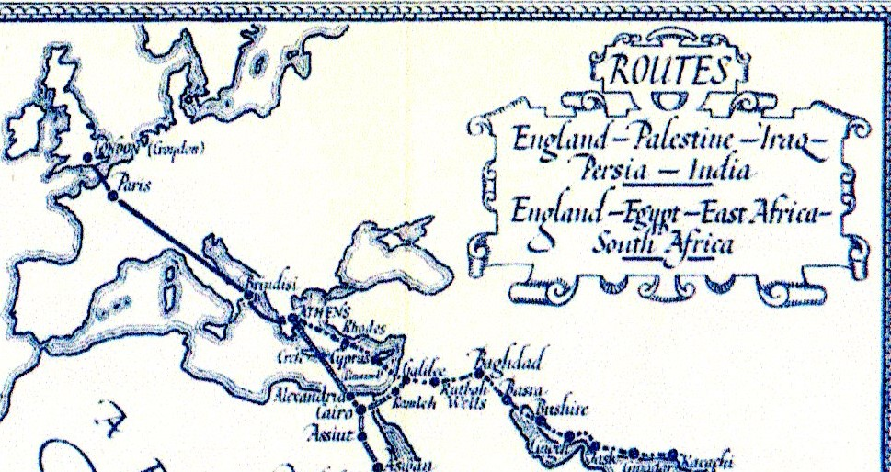
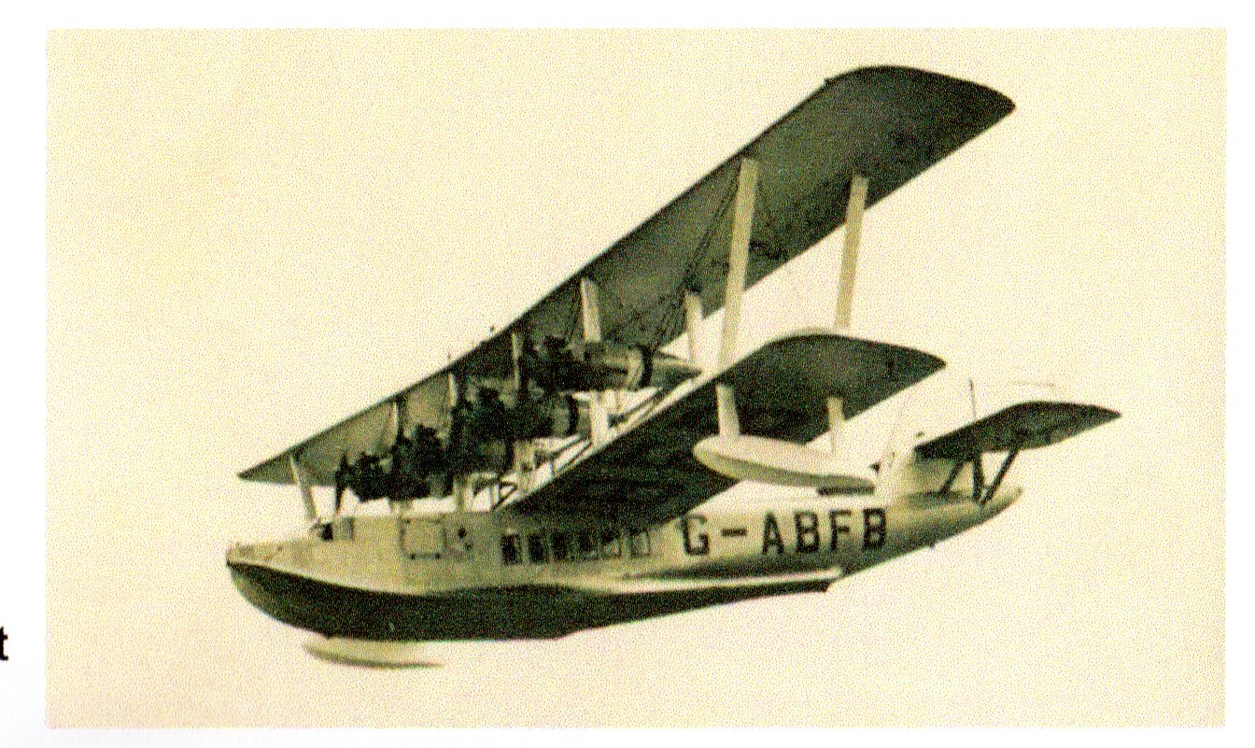
1932 The Direct Airmail Service Imperial Airways included a stop at Limassol on its London – India Service from April 1932 (See Route Shown). From Brindisi the route was operated by Short S17 Flying Boats (see below).

Slide 8
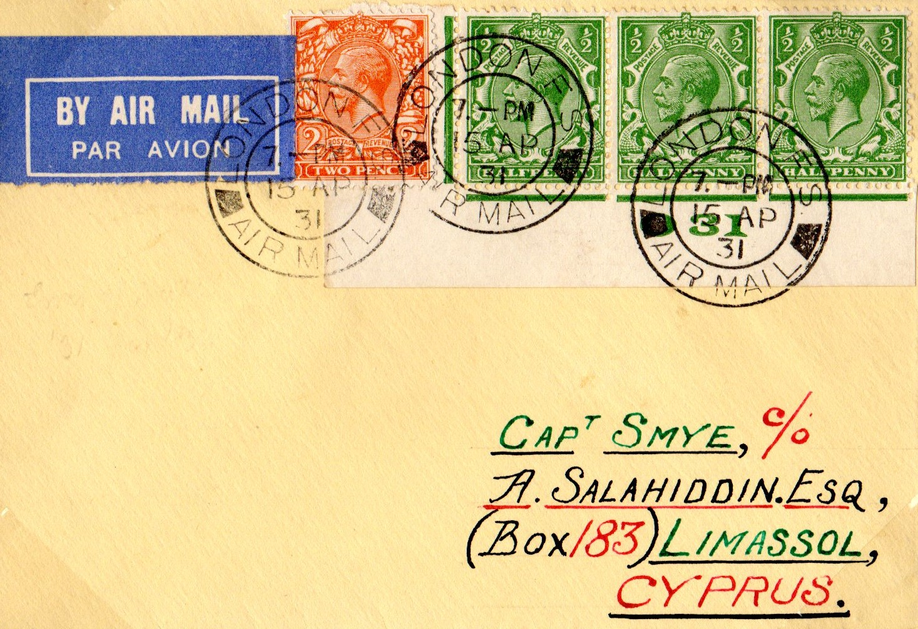
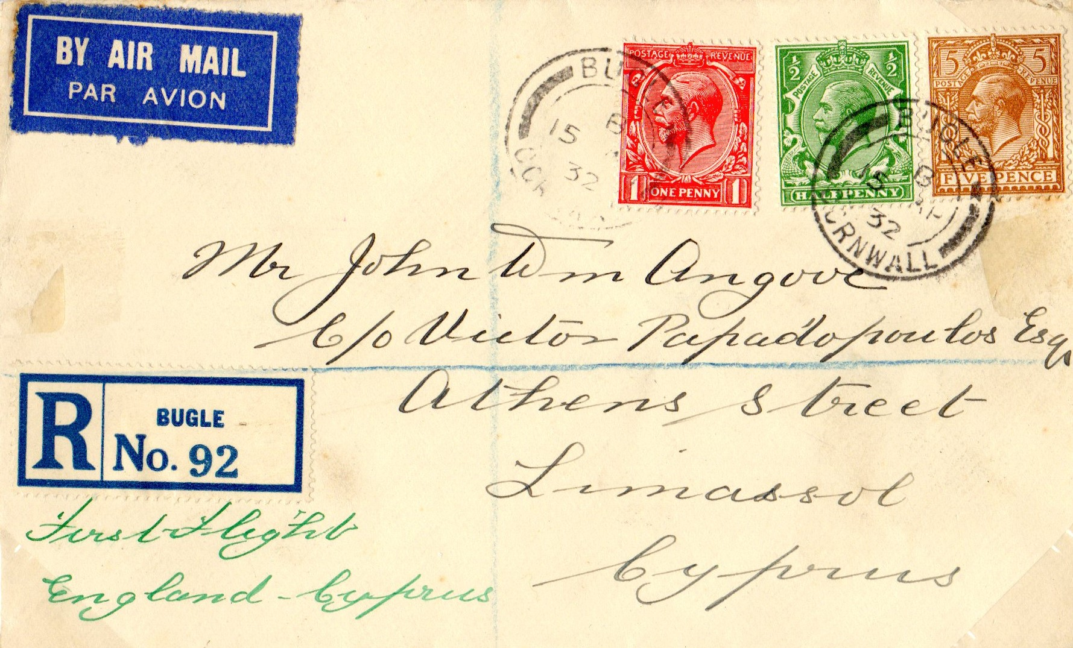
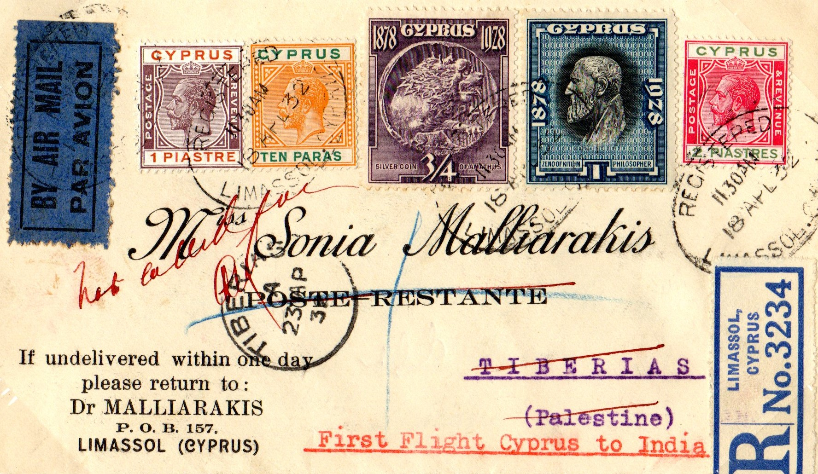
The 1st Eastbound Flight
The 1st flight was operated by Flying Boat “Sylvanus” G-ABFB it landed at Limassol on 19th April 1932
A qty of mail was incorrectly dated 1931 not 1932 see example far right top.
The cover right stated life in Bugle on 15th April 1932 and has no other postal markings – Fee was 3 ½ d inclusive plus 2 ½ d Registration fee.
The above were part of 5 mail bags delivered by this flight
The flight continued to Tiberius the same day with one mail bag added at Limassol.
The cover right is correctly rated as 1 ½ piastres Imperial Letter Rate + 2 ½ piastres Registration Fee + 1 piaster Airmail Fee

Slide 9
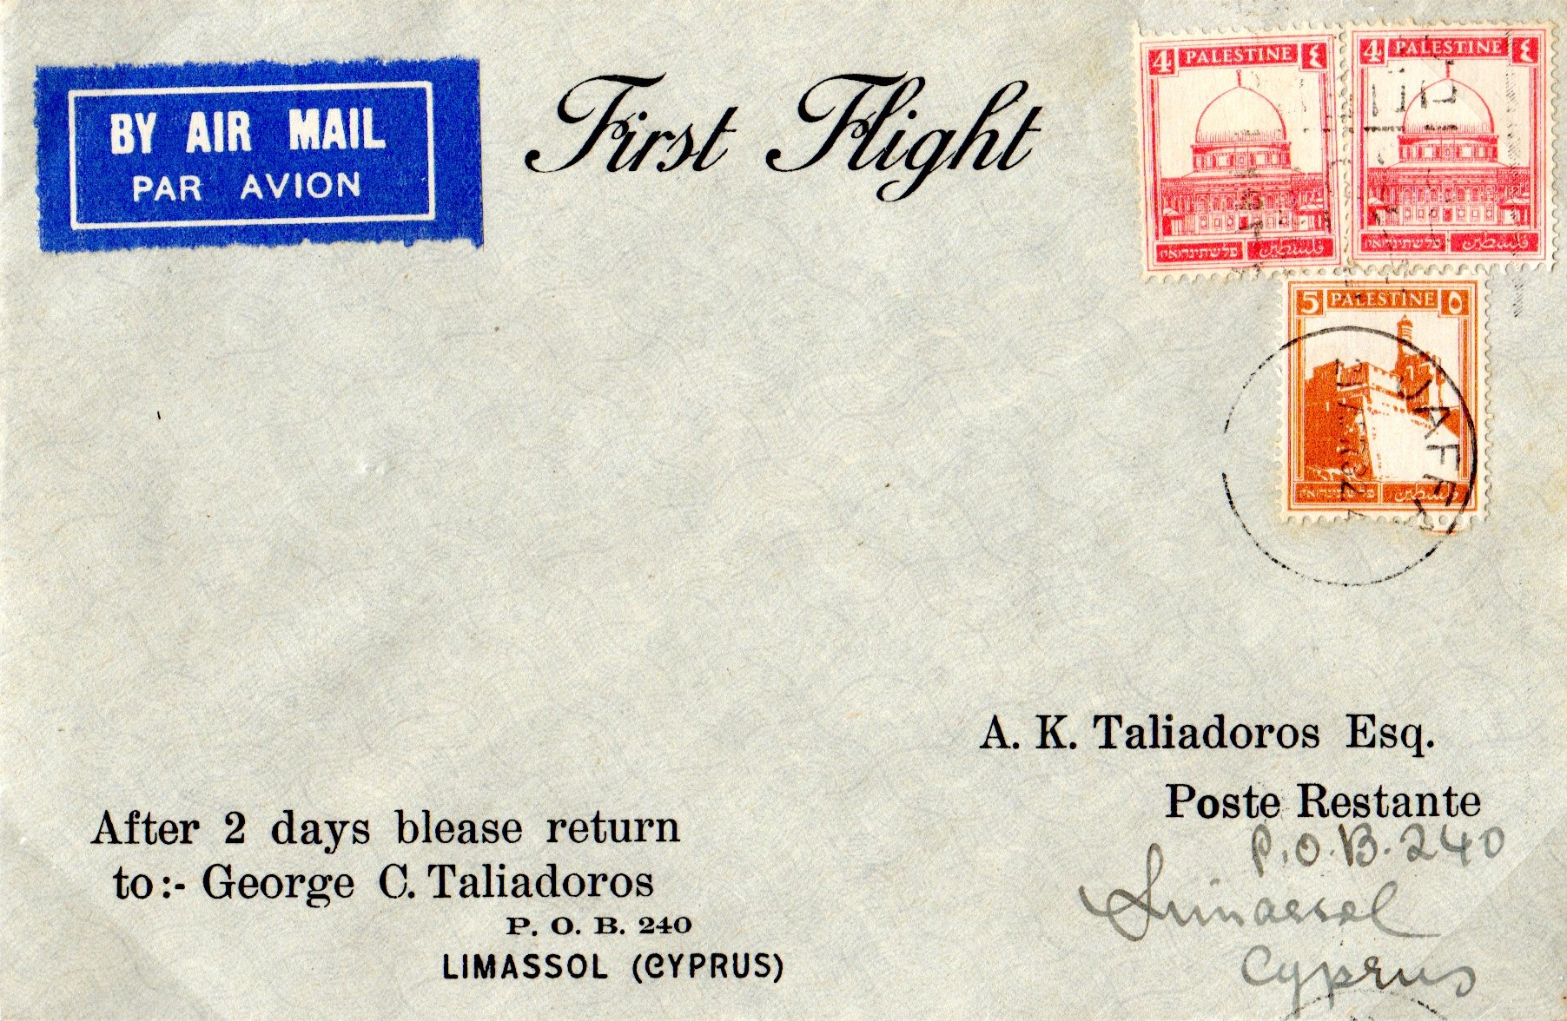
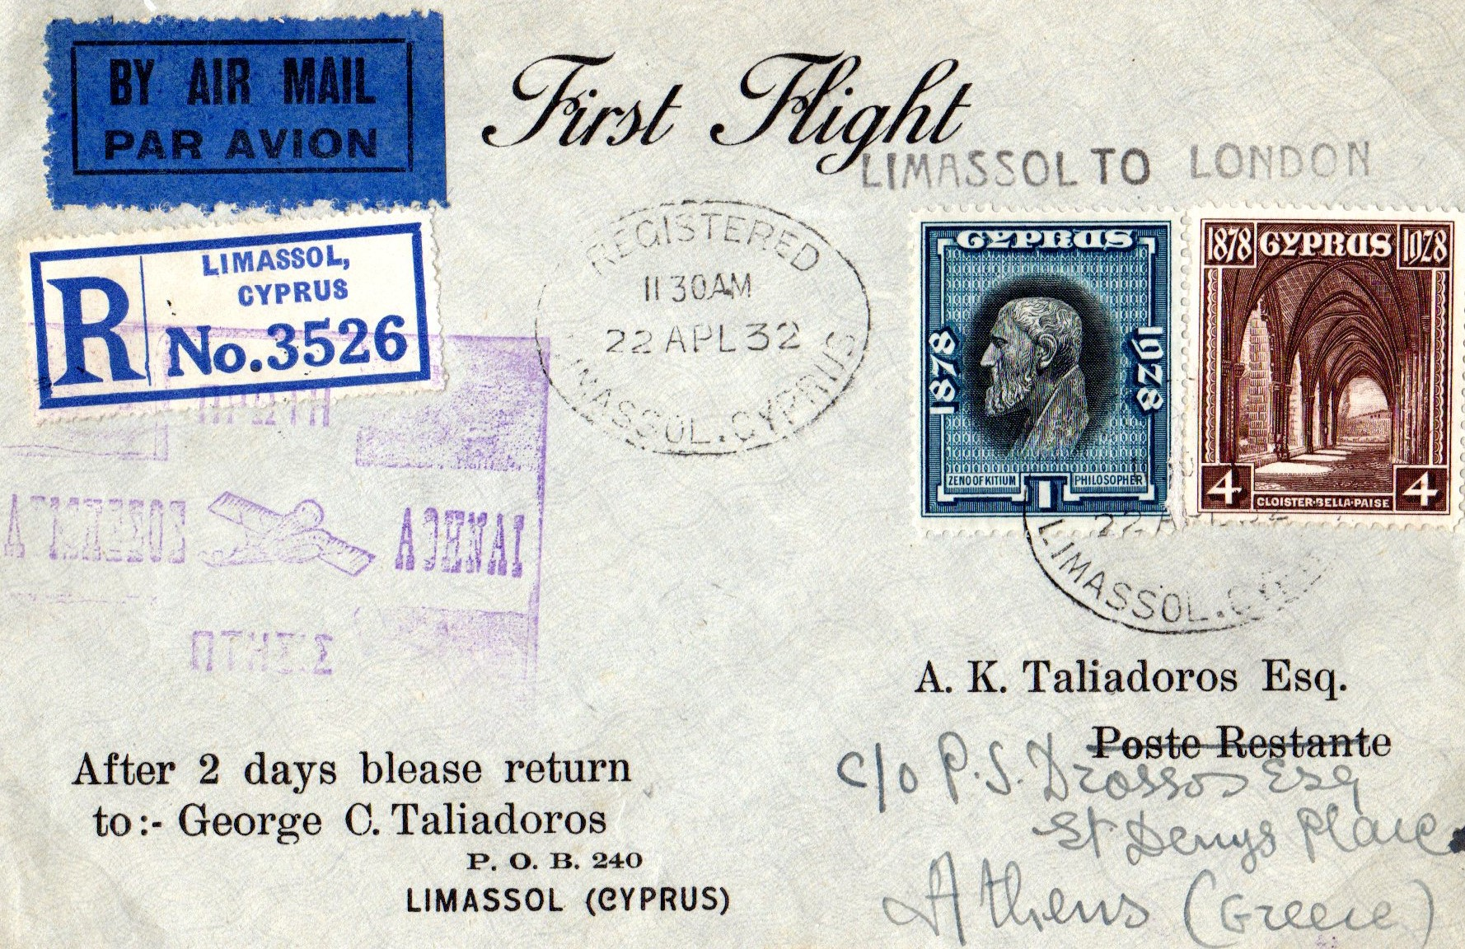
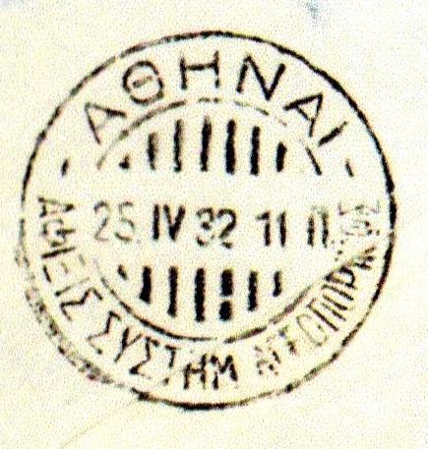
1st Westbound Flight
Recent research has discovered this flight was delayed at Basra for 23 hours & did no reach Cyprus until 8.20 am Sunday April 32. (According to local newspaper reports it carried no mail) The cover right despite stating it is First Flight and dated 22 AP 32 could not have travelled on the 1st Flight.
The aircraft was the same as that of the 1st Eastbound Flight and took off at 09.35 am with 8 mail bags from Cyprus including that shown right, it was not cancelled in Athens until 25th April and has been incorrectly cancelled with a Purple Air Mail cancel it should have been Black.
The Service was suspended on 1st Oct 1932 due to difficulties of landing on The Sea of Galilee and routed further south via Alexandria. There were no direct airmail services to Cyprus until after WW2

Slide 10
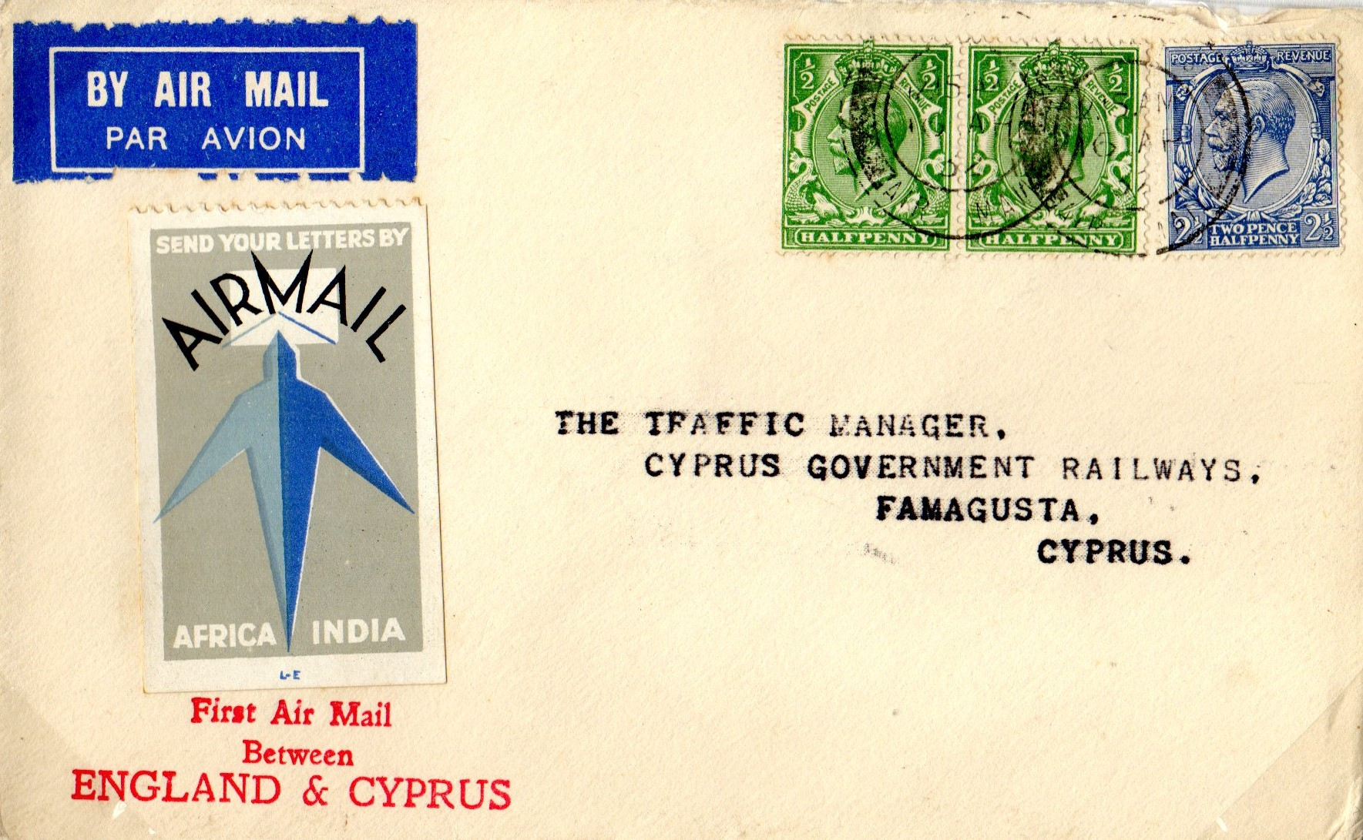
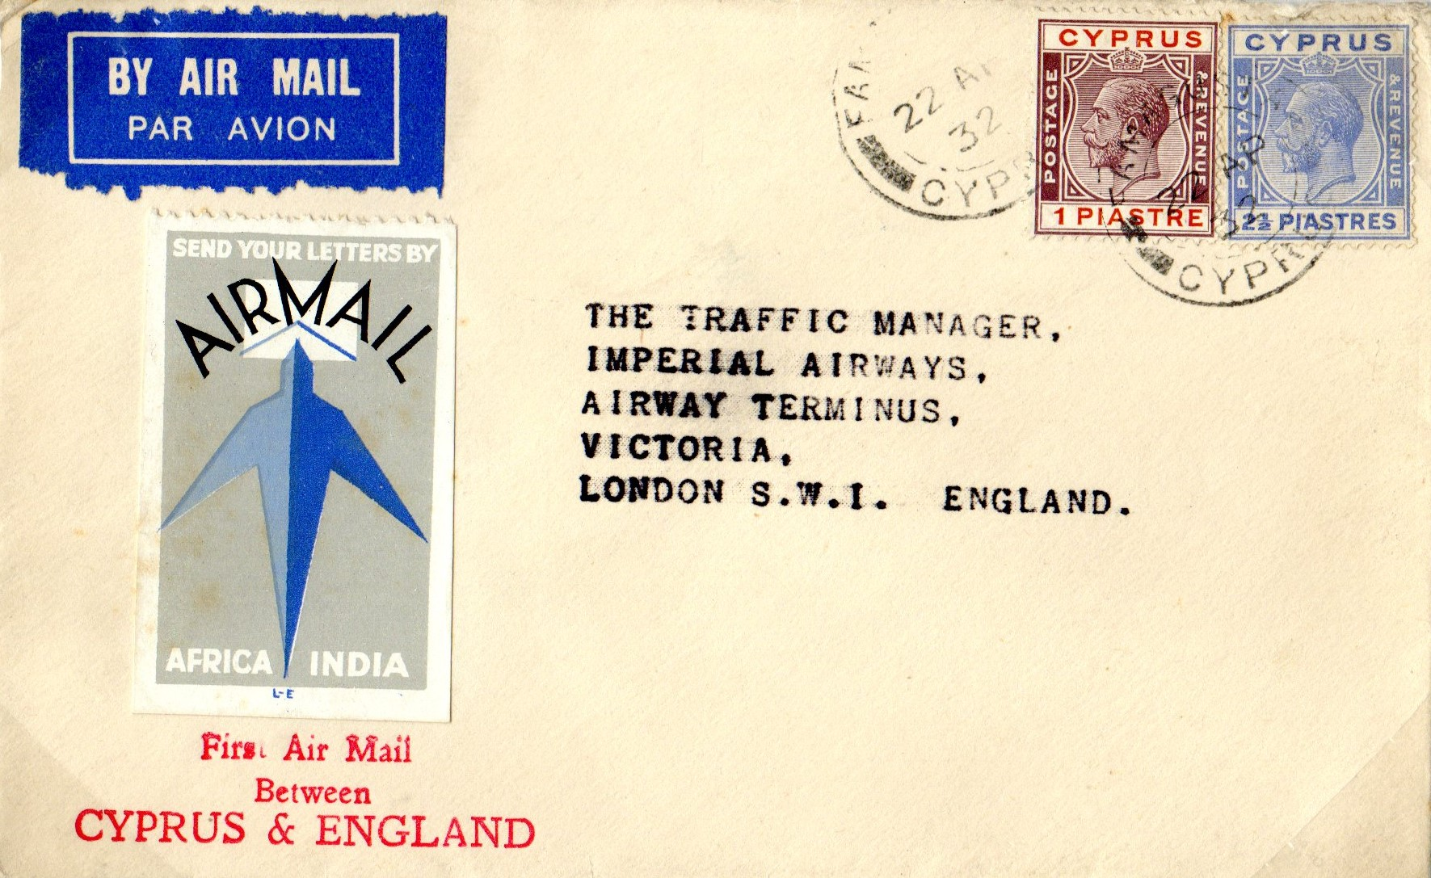
Test Letters
Imperial Airways tested the effectiveness of its routes at many locations using Specially Marked Test Letters.
The covers shown right are to and from The Cyprus Government Railway
It is believed that 75 such covers were produced the postage rate from the UK was 3 ½ d inclusive and from Cyprus the rate was 1 ½ piastres plus 2 piastres Airmail Charge

Slide 11
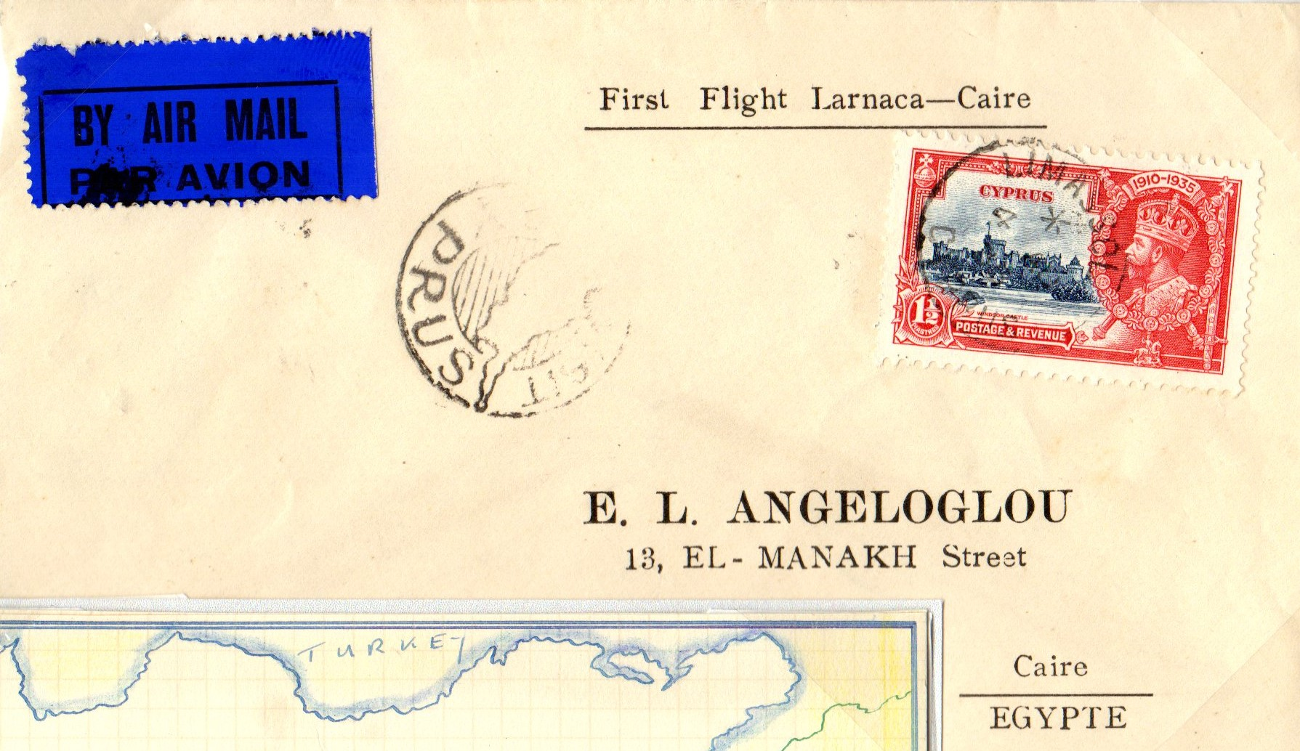
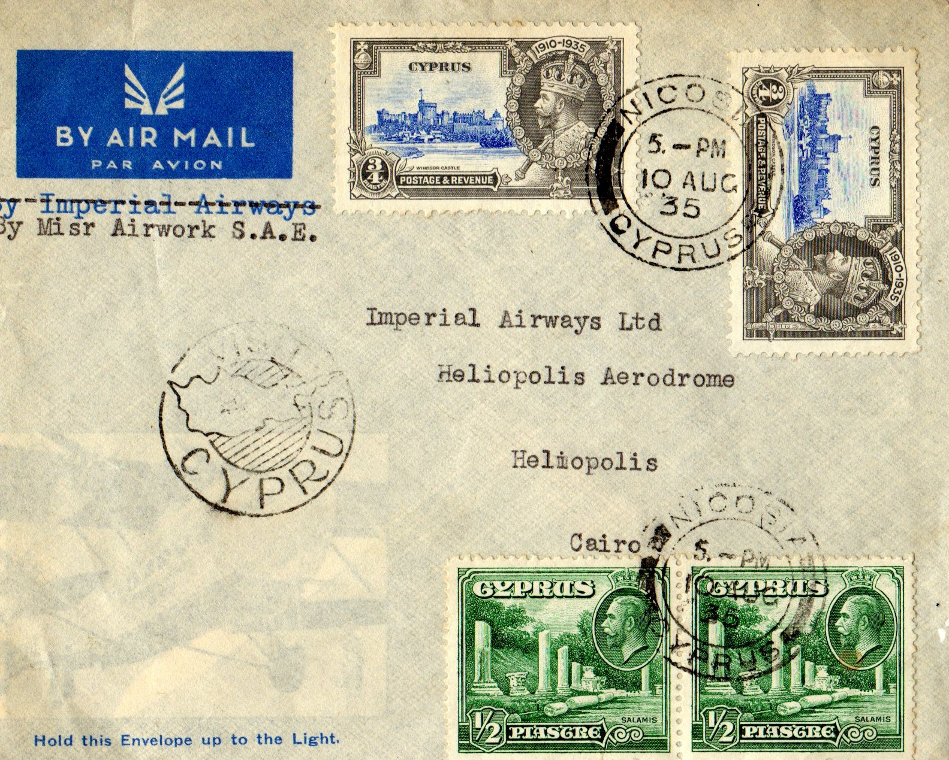
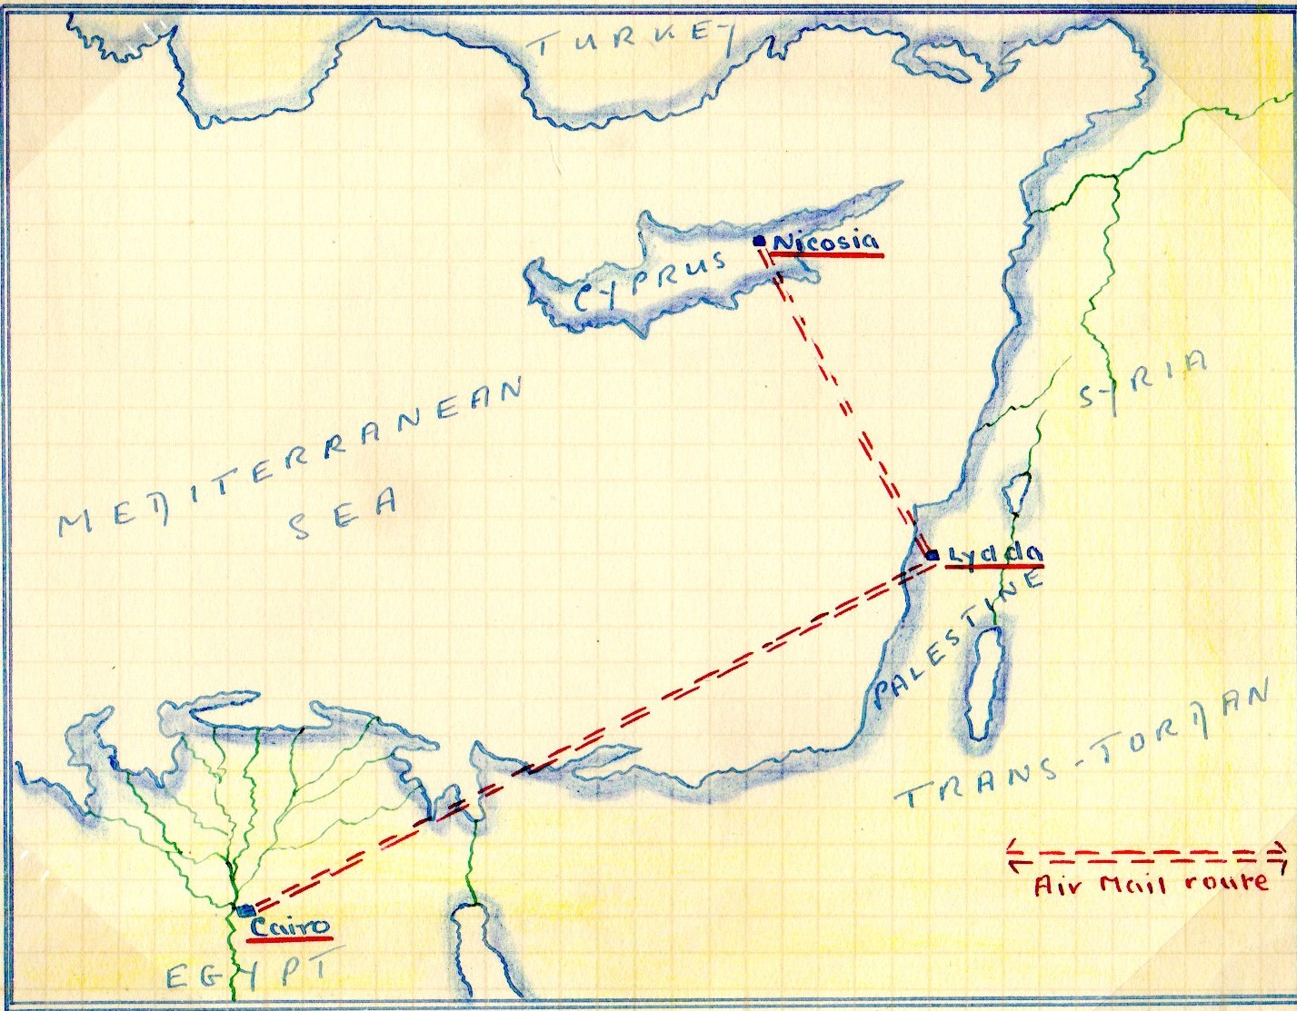
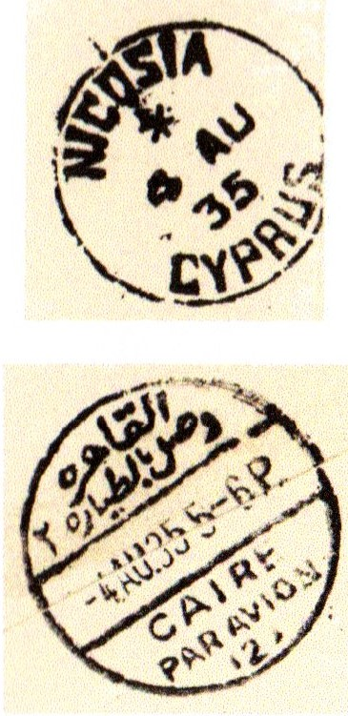
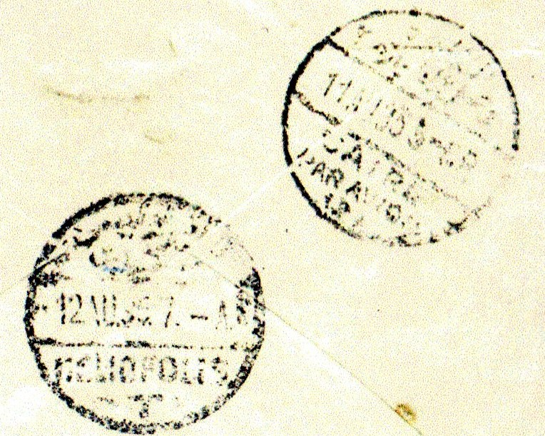
1935 SUMMER AIRMAIL SERVICE This was an Experimental Service the route was Cairo, Lydda and Nicosia operation was 4th Aug 1935 to 20th Oct 1935 the Route is shown below
First Flight covers – That shown right is incorrectly marked Larnaca when it should state Nicosia departure and Arrival marks are shown.
The cover shown below has handling cancels at both Heliopolis and Cairo
The VISIT CYPRUS mark is from the 1st year of usage and is Rare.

Slide 12
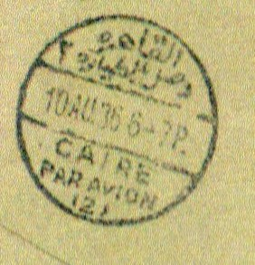
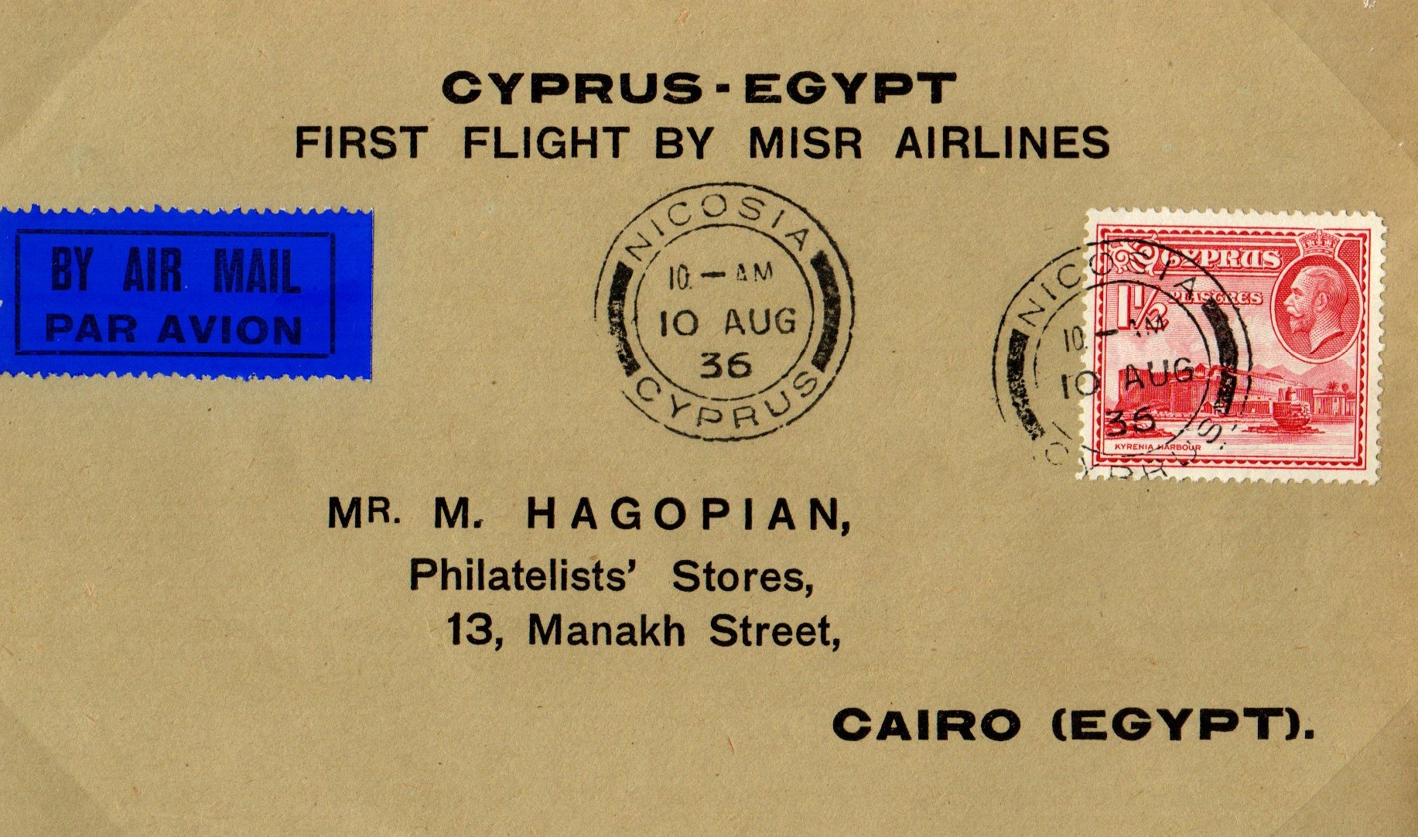
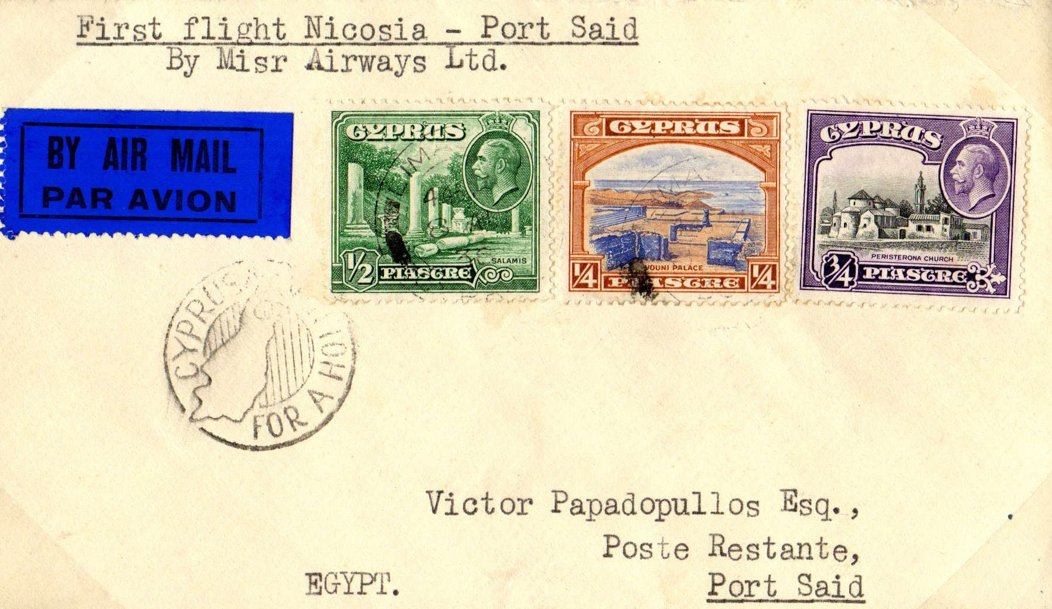
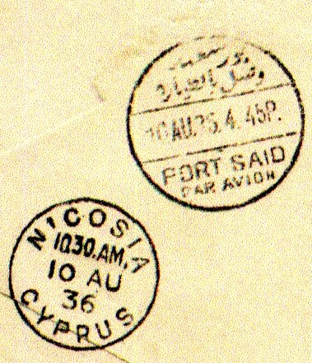
1936-39 Summer Only Service Was operated by MISR Airwork from 10th August 36 with a service as 1935 & operated till 4th Oct 36. From 9th Sept 36 the service was extended to Baghdad. The Summer only service was repeated annually up to WW2
Postage rate for this service was ¾ piastre/1/2 oz The hand stamps of both Nicosia and Cairo show the service was quite quick, but unlike the previous year the journey from Port Said to Cairo was by road.

Slide 13
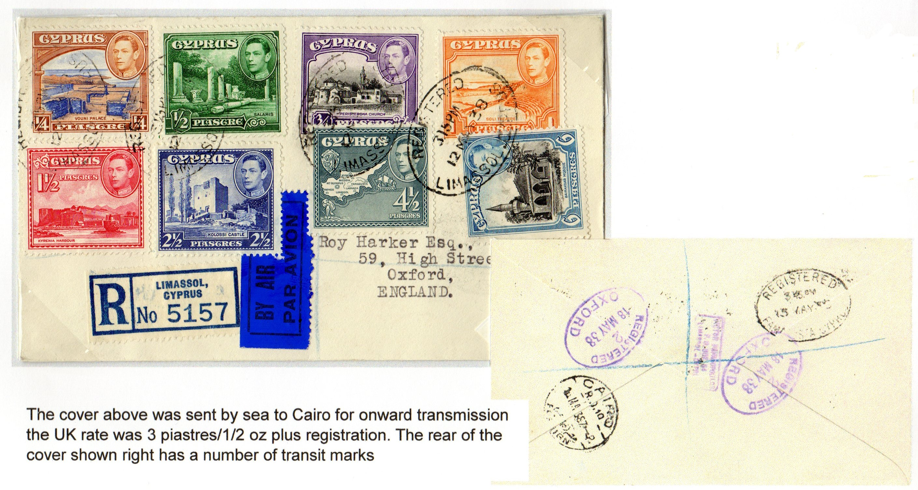
Empire Airmail Scheme –On 27th June 1937 The Empire Air Scheme was introduced allowing 1st class rated mail to travel by air at the normal 1st class rate as Cyprus was not on any direct route it did not qualify.

Slide 14
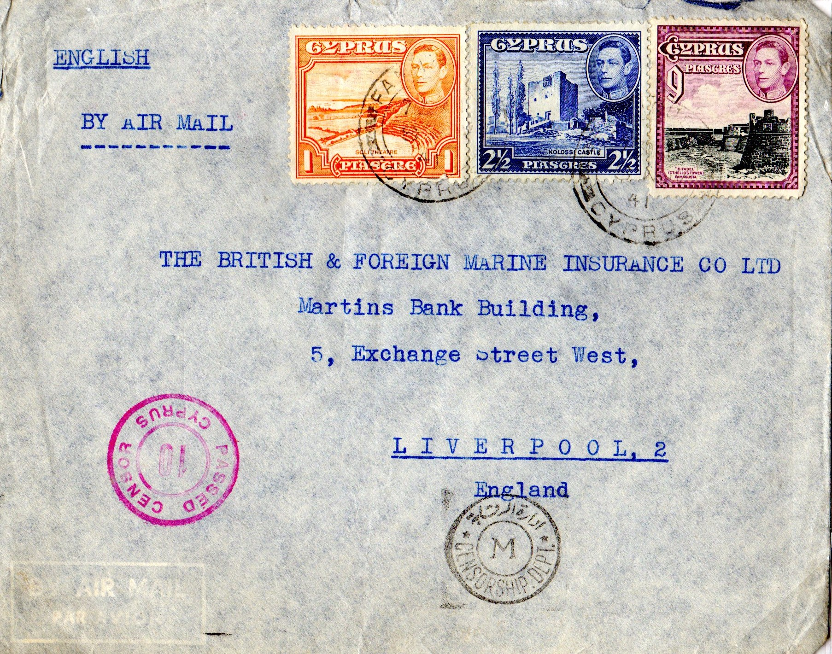
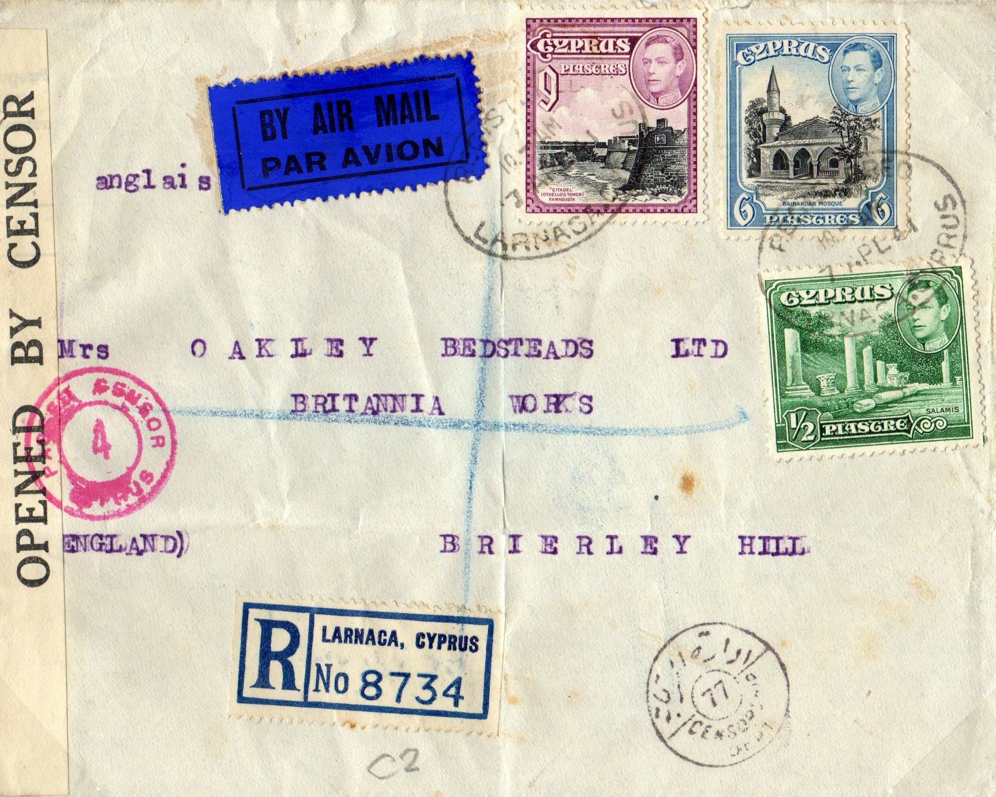
WARTIME SERVICES – Direct services to the UK and many other parts of the world became impossible by Air. From 2nd Aug 1940 mail was carried by sea to Egypt them by Air to Durban then by sea using shipping still operating in the Atlantic.
Both covers carry censor markings only one has actually been opened and re-sealed

Slide 15
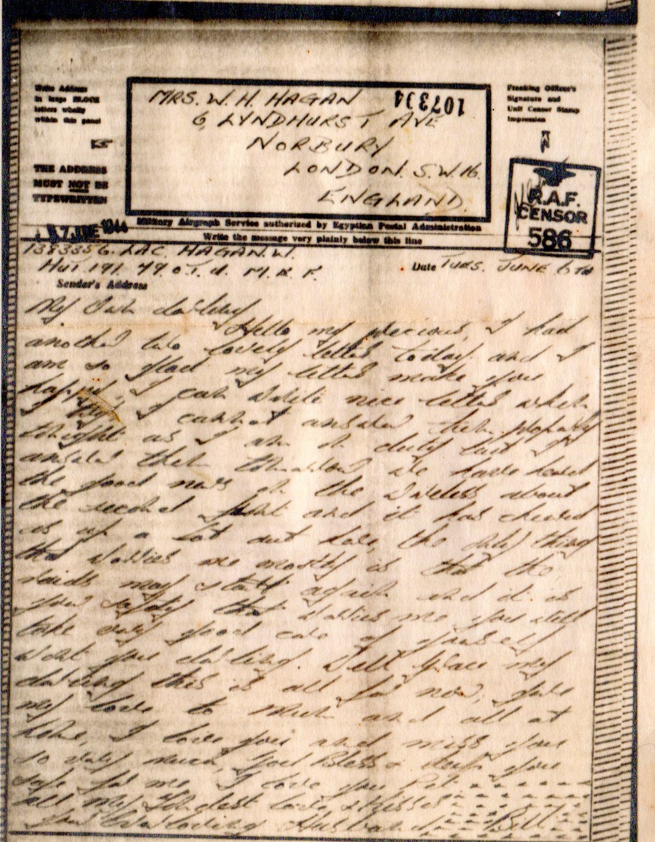
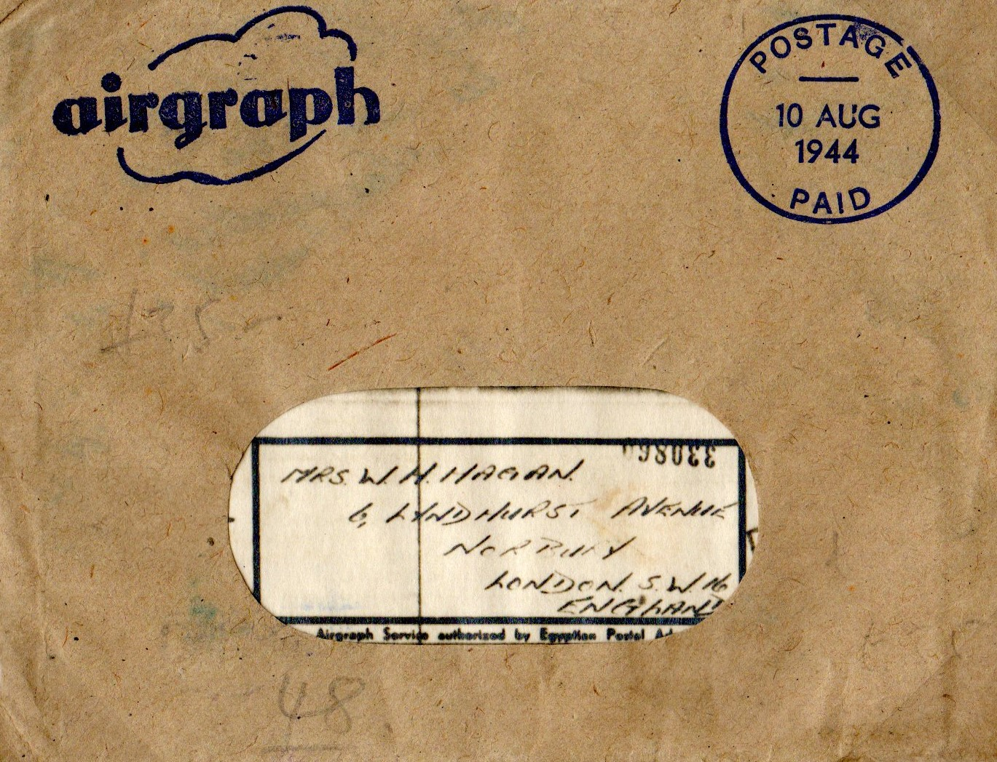
THE AIRGRAPH SERVICE
The service was introduced for Military Personnel as early as Christmas 1941 using special forms passed thro censor and then filmed. The unprocessed film was carried by military aircraft upon delivery the film was processed printed and delivered in special envelopes. The service was extended to civilian use on 1st June 1942
All filming and processing was carried out by Kodak Company who were supposed to destroy all original material

Slide 16
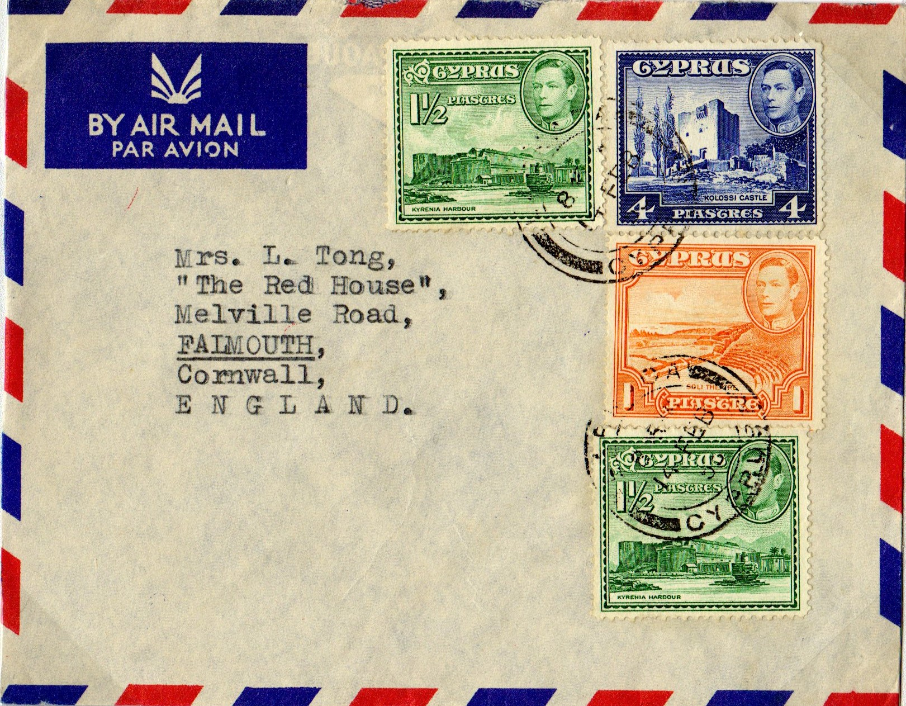
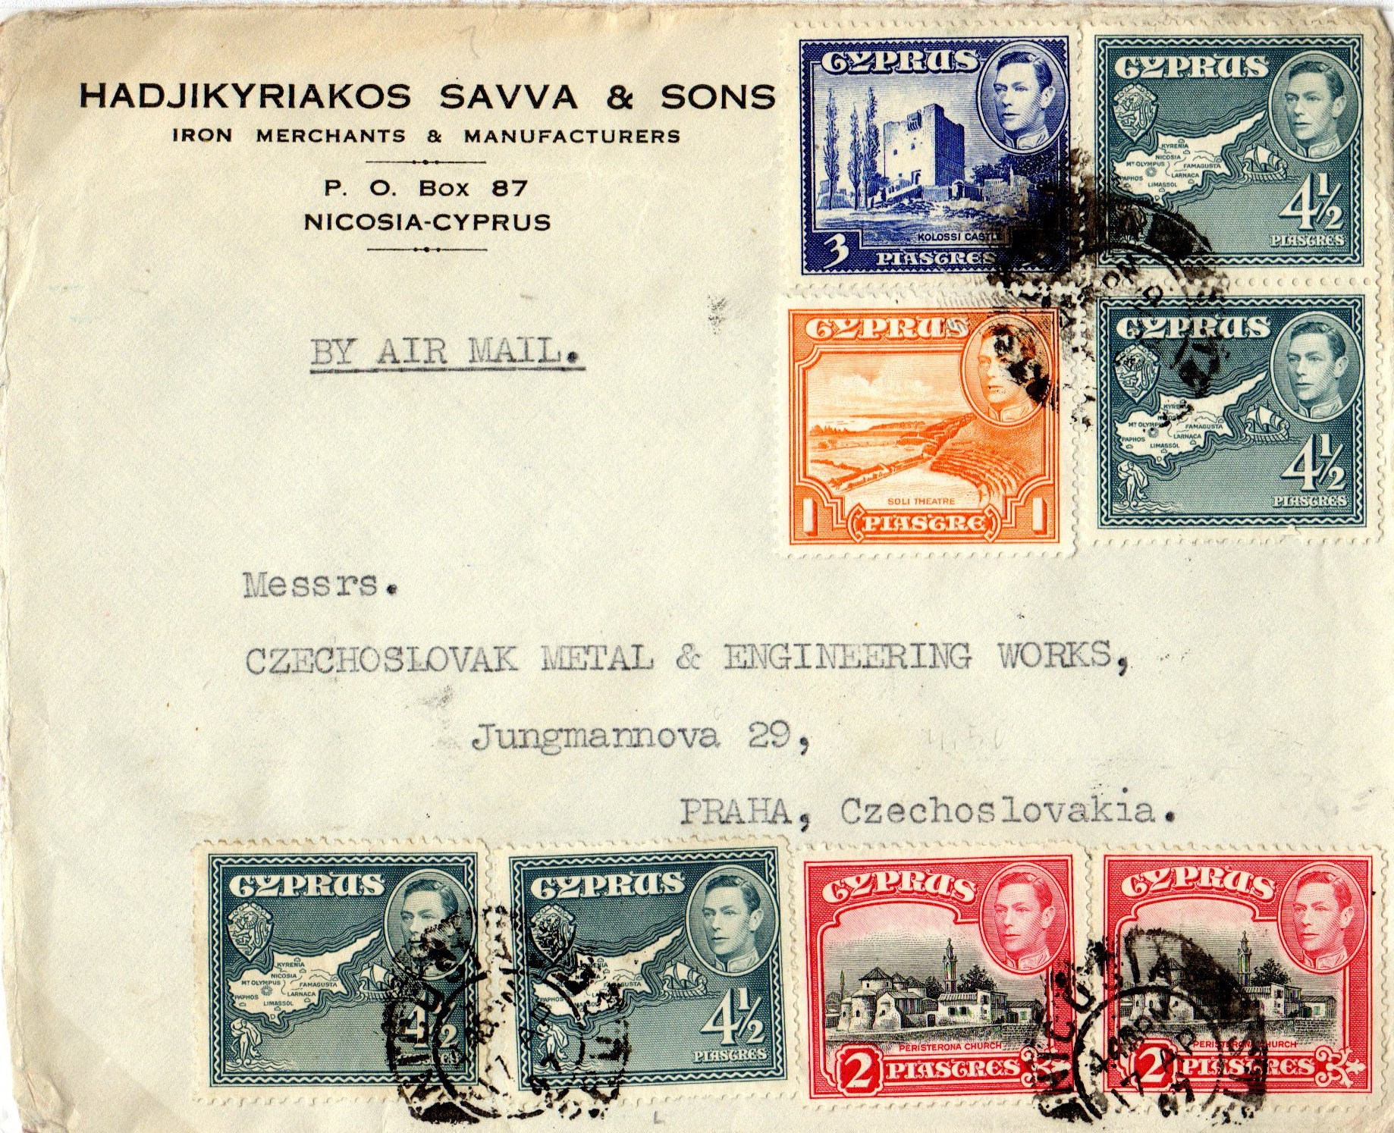
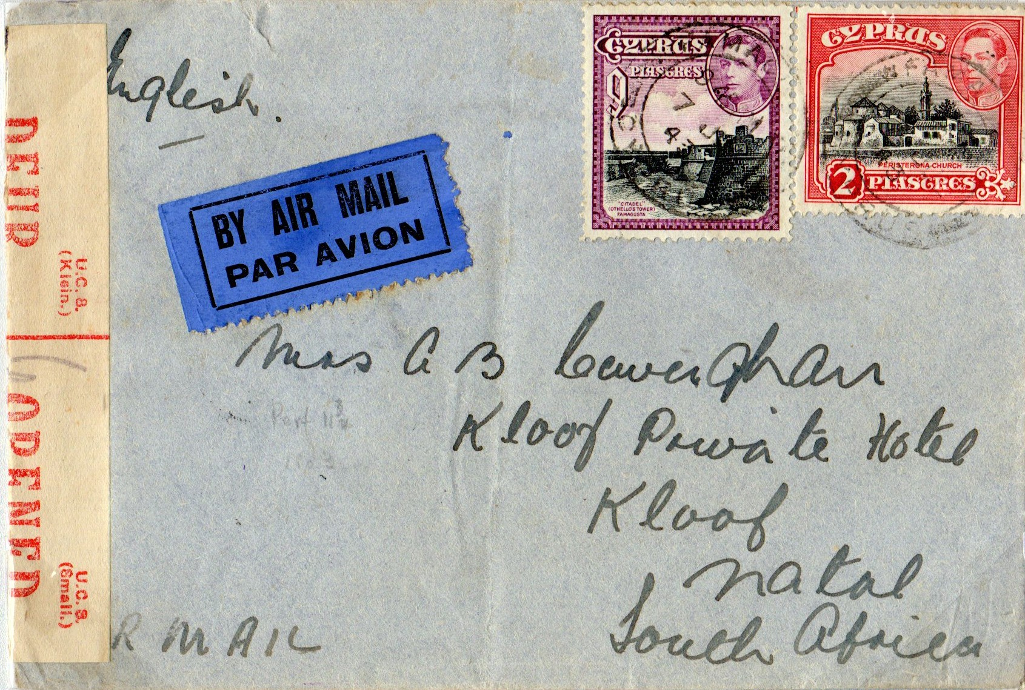
POST WW2 ERA – Direct Airmail Services commenced 1st May 1944 operated by B.O.A.C. the postal rate was 11 piastres/ ½ oz. In January 1950 a new rate of 2 ½ piastres . ½ oz was introduced for 2nd Class Mail Censorship was still being used in some parts of the world.
End of Group

